Slide 1
International Islamic University Chittagong Department of Computer Science & Engineering Course Code: EEE-2422 Course Title: Electrical Drives and Instruments
Submitted by:
Group B
C201202 Farjana Akter Laila
C201211 Sanjida Binta Aziz
C201231 Jesmin Akter
C201234 Jakia Rahman
C201237 Tasnin Jabin
Course Teacher:
Md. Belal Uddin Sifat
Adjunct Faculty
Dept. of CSE, IIUC

Slide 2
Temperature Controlled DC Fan Using Arduino

Slide 3
Table of Contents
Introduction
Circuit Diagram
1
5
Motivation
Result Analysis
2
6
Required Instruments
Future Scope
3
7
Methodology
Conclusion
4
8

Slide 4
Introduction
A DC fan control system based on high temperatures is designed and simulated in this project. This method combines an Arduino with a DHT11 temperature and humidity sensor. By turning on the fan, the room's temperature will be lowered. The DHT11 Sensor will be used to superintend the fan. The temperature will be continuously monitored by the sensor. When the temperature exceeds a predetermined level, the fan will be operating in "On" mode. The room's current temperature will be displayed on the LCD screen.

Slide 5
Motivation
The typical fans in homes and businesses are controlled by a manual system. A rotary switch with an inside potentiometer is used to control it. There are some issues with this system that affect user comfort. As the temperature and weather conditions fluctuate throughout the day, for instance, the speed of the fan needs to be adjusted at regular intervals manually.
To get rid of this problem we have implemented this project to control the fan automatically .

Slide 6
REQUIRED INSTRUMENTS
Arduino Uno R3
DHT11 Temperature & Humidity Sensor
DC Fan
LCD 16X2
NPN Transistor
Diode
Potentiometer
9V Battery
Breadboard
Jumper Wires

Slide 7
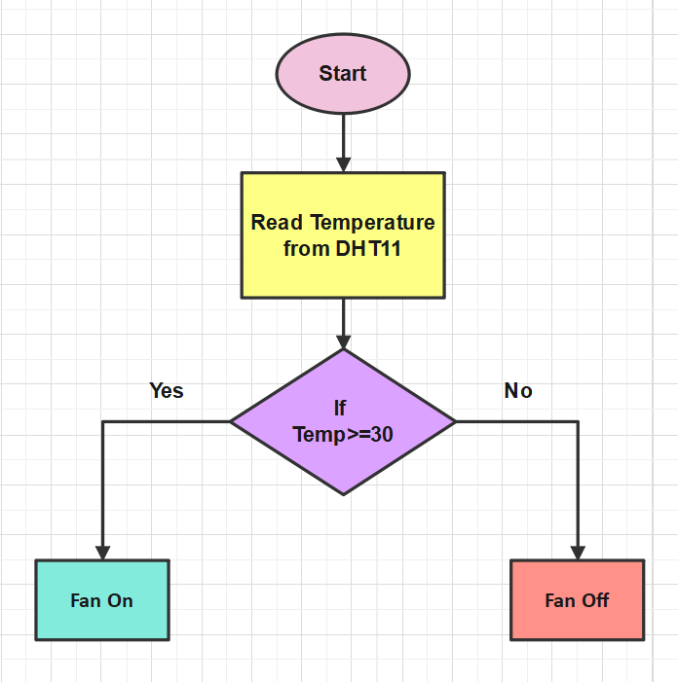
Methodology
Figure : Flowchart of Temperature Controlled DC Fan

Slide 8
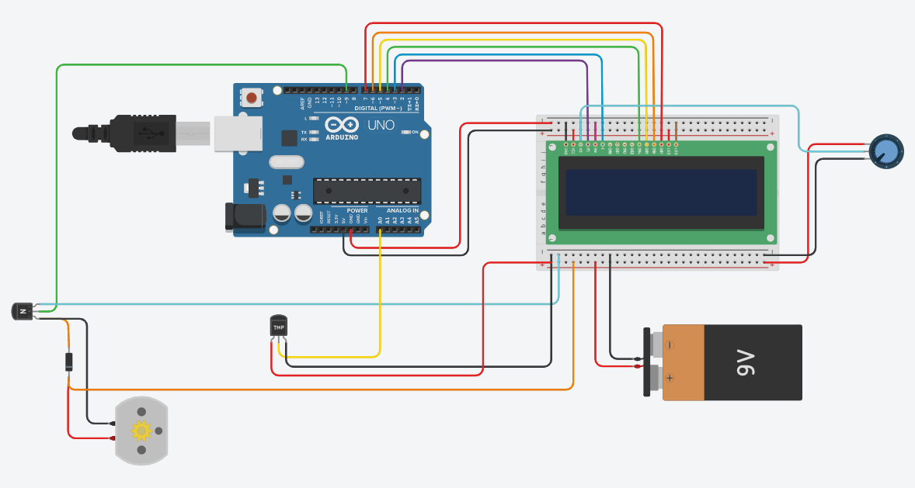
Circuit Diagram
The schematic above shows the 3D details of the hardware simulation. Here you can see what the components look like and the detailed connections between these components. This estimation project works in several phases. The temperature is detected by the humidity and temperature sensor, namely the DHT11. After reading the DHT11 sensor module's output and converting the temperature data to the correct number in degrees Celsius, another component controls the fan. Finally, the system tells whether the fan is on or off and shows the temperature on the LCD panel.

Slide 9
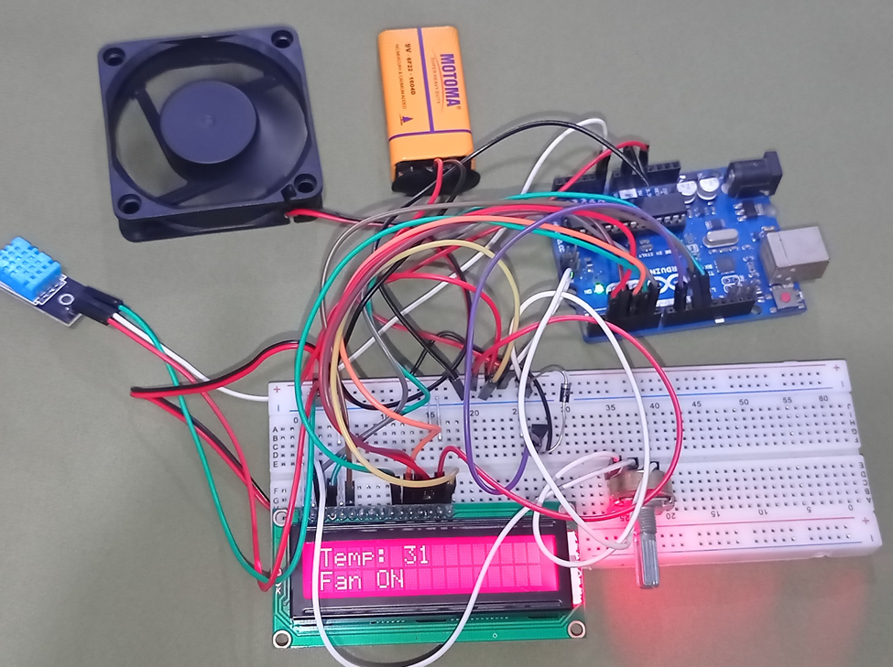
Result Analysis
Figure : Picture of implementation

Slide 10
Result Analysis
The main outputs of this effort are two. One was to automatically display the temperature on an LCD display, and the second automatic fan ON/OFF switching was even more crucial for continuously monitoring the temperatures. Temperature output and fan status are both produced by LCD displays. It is visible that the LCD panel is showing a temperature of 31 degrees Celsius and that the fan is now turned on. In fact, fan operation depends on the thresholds set. Set the value to 30 degrees Celsius.
For example, when the temperature drops below 30 degrees Celsius, the fans will automatically turn off. You can see the display interface with breadboard and Arduino hardware.

Slide 11
Future Scope
To cool off mechanical gears.
Affix various devices to this tool to command its functionality.
Fruitful for handicapped people.
Operate in industrial and establishment sites.

Slide 12
Conclusion
Arduino was successfully programmed to settle the speed of the fan, compare the room temperature to a reference temperature, and output the results over a Screen.
When the temperature rises over the threshold temperature, the fan turns "on," and when it falls below, it turns "off." It is therefore essentially an automated procedure.
This project can be used wherever internal temperature of circuit got to be stabilized or saving it from overheating. This will increase its efficacy and make it more practical for large areas extremely in warm weather.
In conclusion, the apparatus has achieved its main objective of using an Arduino Uno and a temperature controller to regulate the speed of a DC fan.

Slide 13
Thank you!

